Slide 1
Design and development of a board game -
Strategical TicTacToe
202302_Guided Research
07/31/2023
Student: Anar Shikhaliyev
Professors:
Stephen H. Kaisler, D.Sc.
Jamaladdin Hasanov, Ph.D.
Notes:
Themes: What is the issue and how would it affect one's nursing practice? What is your group's position on the subject? How can you use EBP to effectively advocate policy addressing the issue?
Slide topics:
-Overview
-History
-NLC vs eNLC
-eNLC Adoption Process
-Current state of eNLC
-Nursing advocacy
-DC vs VA nursing licensure

Slide 2
Project Objective
Brief answers to Heilmeir questions
Investigate and implement various AI algorithms for the game.
Designed and developed a board game with tactical decision-making and strategic planning elements.
Analyzed different AI approaches, including heuristics, minimax, alpha-beta pruning, adversarial search algorithms, and memorization, to enhance AI performance.
Unique heuristics - strategies to evaluate the board and combining tactical and strategic elements.
Develop different agents and measure the performance of the different algorithms.
Notes:
Colduvell, K. RN, BSN, BA, CBC. (May 23, 2018). Updated Map: Enhanced Nursing Licensure Compact (eNLC). Nurses.org. Retrieved from https://nurse.org/articles/enhanced-compact-multi-state-license-eNLC/
Diana’s Slide

Slide 3
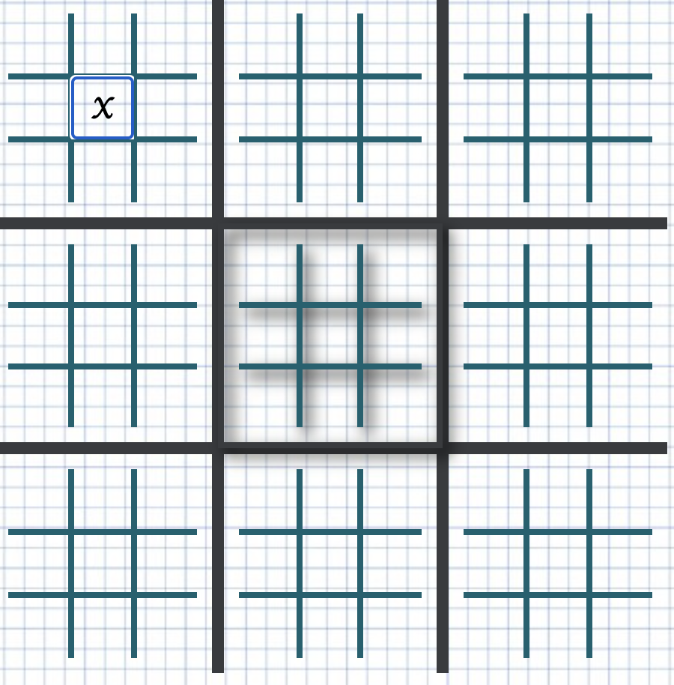
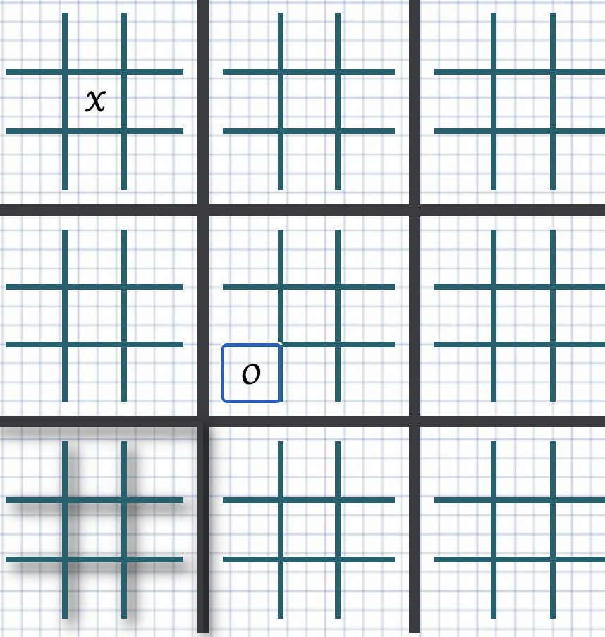
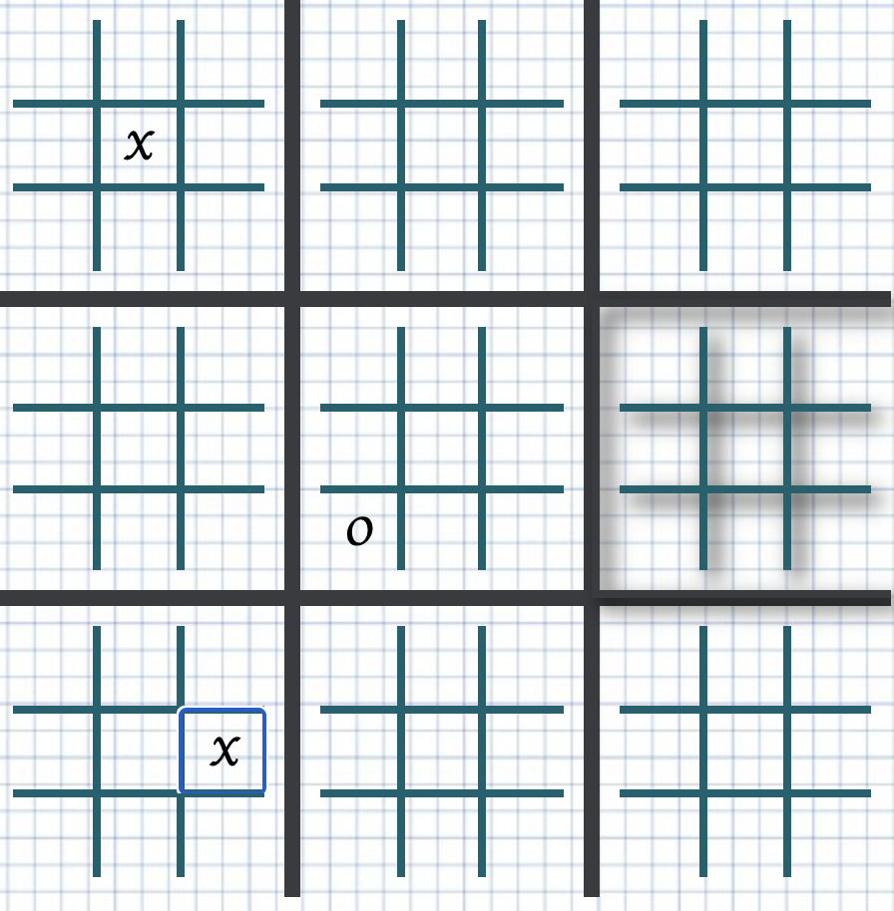
Game rules
The board is made up of 9 small 3-by-3 boards that, when put together, make one big 3-by-3 board. Each player takes a turn, and just like in standard Tic-Tac-Toe, a player gets a small board by putting one of the symbols(X/O) in a row. When a player wins a small board, they move their sign to the spot on the big board where the small board was. The game stops when one person gets three of the same symbol in a row on the big board, or when all the squares are used up and there is a tie.
Each player must place their symbol on the small board where the previous player's symbol was placed:
Notes:
Ashlee

Slide 4
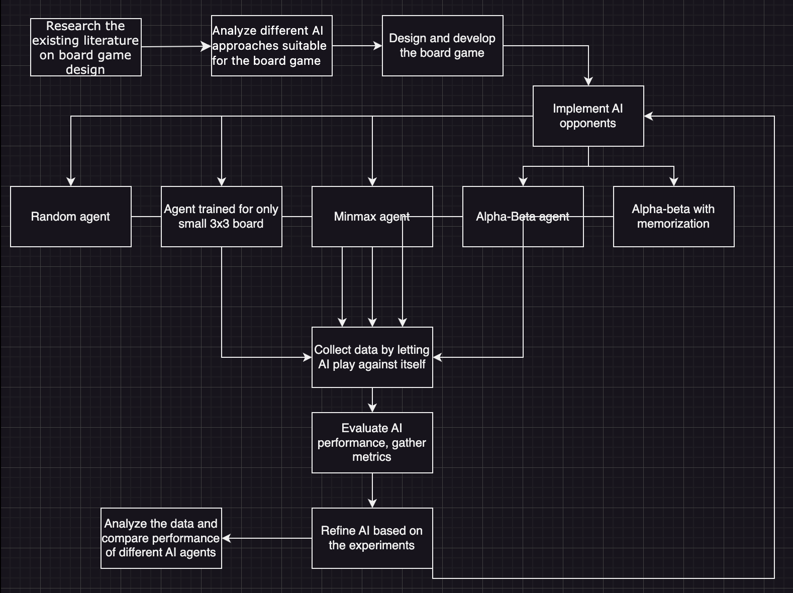
Technical Approach
Notes:
https://nurse.org/articles/enhanced-compact-multi-state-license-eNLC/

Slide 5
AI agents
Random Agent - agent that does stochastic actions.
Partially genius agent
AI agent which is highly competitive in a normal 3 by 3 games and considers only the playable current board.
Minimax Agent
Agent using Minimax algorithm to travel through the whole tree
Alpha-Beta with memorization
The Minimax method, augmented with alpha-beta pruning, used to reduce the quantity of pathways examined by the algorithm.Storing scores of the previously traversed boards in the act of avoiding the recalculation of previously assessed positions in order to save time.
Notes:
National Council of State Boards of Nursing, Inc (NCSB). (2017, December 12). The interstate commission of nurse licensure compact administrators. Retrieved from https://www.ncsbn.org/finalrules.pdf

Slide 6
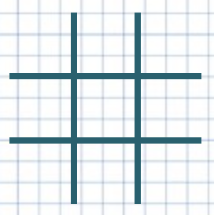
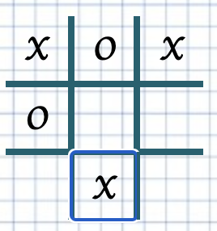
Heuristics
Heuristic - 2
The scoring also based on occurrences of player and opponent symbols in rows, columns, and diagonals. But, the heuristic assigns scores of +10 for player winning patterns and -10 for opponent winning patterns. The score is used to assess the board's desirability for the player.
Strengths
Quick Evaluation: The algorithm swiftly checks rows, columns, and diagonals for winning patterns to make heuristic judgements during gaming.
Simplicity: The heuristic is basic, understandable, and implementable, making it suited for simple applications and rapid prototyping.
Weaknesses
Lack of Depth: The heuristic only analyses immediate winning rows, columns, and diagonals. It does not include preventing opponent threats or generating winning possibilities.
No Board Control: The algorithm does not consider board control or strategic placement, which might provide an advantage in the game.
Overemphasis on Immediate victories: The heuristic gives immediate player victories a high score of 10, which may lead to concentrating primarily on short wins rather than longer-term methods that might generate greater outcomes.
Lack of Weighting: All winning patterns—rows, columns, and diagonals—are equally weighted, which may lead to poor judgements in complicated game circumstances.
Heuristic - 1
The scoring of a board is determined by analysing the presence of a certain pattern, denoted as 'X' for player 1 or 'O' for player 2, in rows, columns, and diagonals. The use of memoization is employed in order to keep previously calculated board evaluations inside a memory dictionary, hence enhancing the efficiency of subsequent computations.
Strengths
Customizable Target - The target parameter allows the algorithm to evaluate the board for different players (e.g., 'X' or 'O'), making it flexible and adaptable for both players in a two-player game.
Weaknesses
simplistic: The algorithm's heuristic evaluation is based solely on the occurrence of the target pattern in rows, columns, and diagonals. It does not take into account other aspects, such as board control, potential threats, or blocking moves, which may limit its strategic depth.
Lack of Context: The algorithm analyses the board position without considering the game circumstances, opponent's actions, or future ramifications. In complicated game settings, it may overlook chances or make bad judgements.
Lack of Weighting: The method treats all target pattern occurrences in rows, columns, and diagonals identically. It does not distinguish between crucial and less important positions, possibly resulting in unsatisfactory judgements for the big board.
+10
row score: 0
col score: 1
dia score: 2
+10
+10
Notes:
National Council of State Boards of Nursing, Inc (NCSB). (2017, December 12). The interstate commission of nurse licensure compact administrators. Retrieved from https://www.ncsbn.org/finalrules.pdf

Slide 7
Heuristic - 3
The heuristic evaluates winning patterns differently for smaller and bigger boards, considers player control over the next small board move, and employs memorization to speed up future computations. Especially strong in the free zone stage of the game.
Strengths
Comprehensive Evaluation: The algorithm considers player and opponent winning patterns, player control over the next tiny board move, and smaller and bigger boards. This gives a fuller board evaluation.
Memoization: The method memorises board evaluations to minimise unnecessary computations and improve performance.
Weaknesses
Player Control Consideration: The algorithm considers the player's next little board move, which may reveal strategic posture and possible benefits.
Board Position Analysis: The algorithm ignores the location of the smaller boards inside the Ultimate Tic-Tac-Toe board, which might affect strategic choices.
Lack of Depth: Although the heuristic examines numerous aspects, it does not include more advanced methods like strategic blocking or trapping the opponent.
Heuristic - 4&5&6
Combination of 3 heuristics:
Evaluates the winning position of the large board
Evaluates the whole board in the domain of the small board
“Forward chaining” -considers next evaluation and the state of the next playground and adds it to the overall score
Strengths
Comprehensive Evaluation: The heuristics evaluate winning sequences, centre movements, and corner moves for both players on the bigger board (heur4) and each smaller board (heur5).
Balanced Scoring: Winning sequences and smart movements relatively get lower incremental points for more nuanced assessments:
capturing center cell/board
capturing corner cell/board
capturing the cell resulting in the sequence of cells
Player-Controlled Sequences: Heuristics reward player-controlled winning sequences, promoting strategic play.
Weaknesses
Fixed Incremental Scoring: The heuristic scores may not appropriately represent the strategic value of various plays or winning sequences.
Lack of Evaluation Depth: The heuristics do not include advanced strategic factors like opponent blocking or long-term planning, which might lead to poor decision-making.
Notes:
National Council of State Boards of Nursing, Inc (NCSB). (2017, December 12). The interstate commission of nurse licensure compact administrators. Retrieved from https://www.ncsbn.org/finalrules.pdf

Slide 8
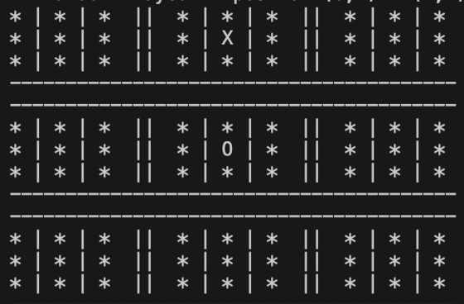
Depth
Up until this point, I have used a fixed depth(3) for all of the tree-traversing agents. However, the significance of depth varies over various phases of the game. During the first phases of the game, the search space remains very expansive. During the endgame phase, the available search area becomes much reduced, hence amplifying the significance of movements that might lead to a favourable outcome.
The significance of speed is noteworthy; nonetheless, it is crucial to acknowledge that as the depth increases, the number of nodes in the tree increases exponentially, thus leading to a corresponding exponential growth in the time required to traverse the tree.
Notes:
National Council of State Boards of Nursing, Inc (NCSB). (2018, August 6). Nurse Licensure Compact (NLC). Retrieved from https://www.ncsbn.org/nurse-licensure-compact.htm

Slide 9
Results
There are various records for the different games played by different agents in both directions( they take turns when it comes to who will start first). There are every combination of these 4 agents playing with each other(less important ones excluded from the presentation):
Random
Part genious agent
Minimax
Alpha-Beta(with memorization)
When it comes to heuristics, strength level also follow the upward direction as in their names:
6+5+4>3>2>1
Notes:
Bowblis, J. R., Meng, H., & Hyer, K. (2013). The Urban-Rural Disparity in Nursing Home Quality Indicators: The Case of Facility-Acquired Contractures. Health Services Research, 48(1), 47-69. doi:10.1111/j.1475-6773.2012.01431.x

Slide 10
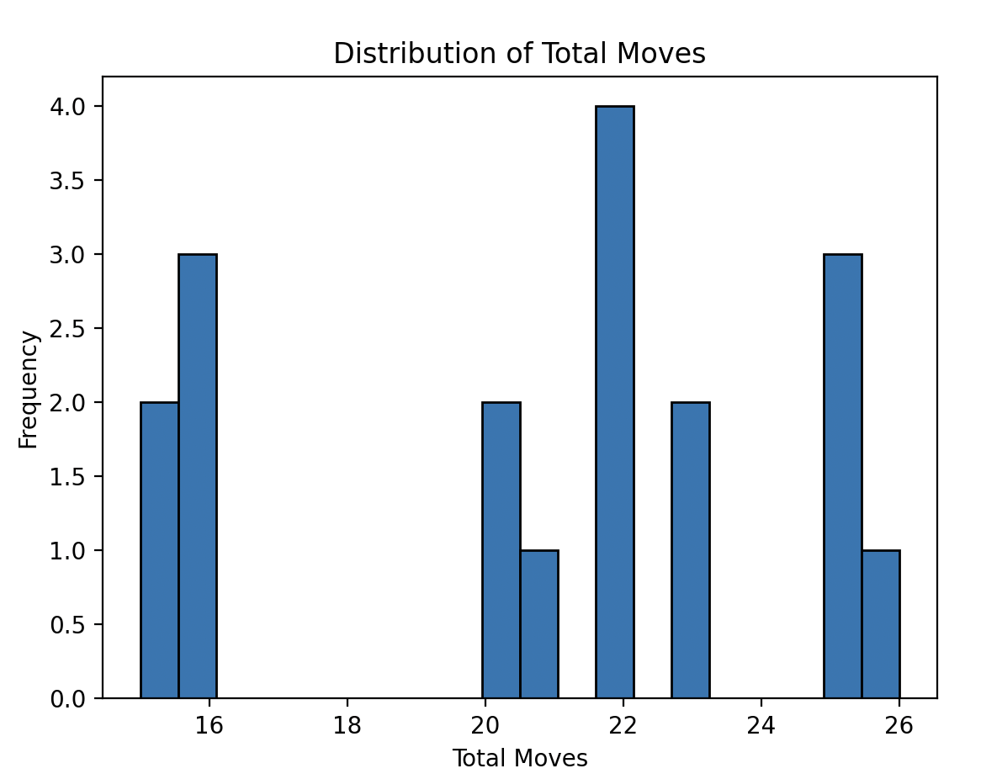
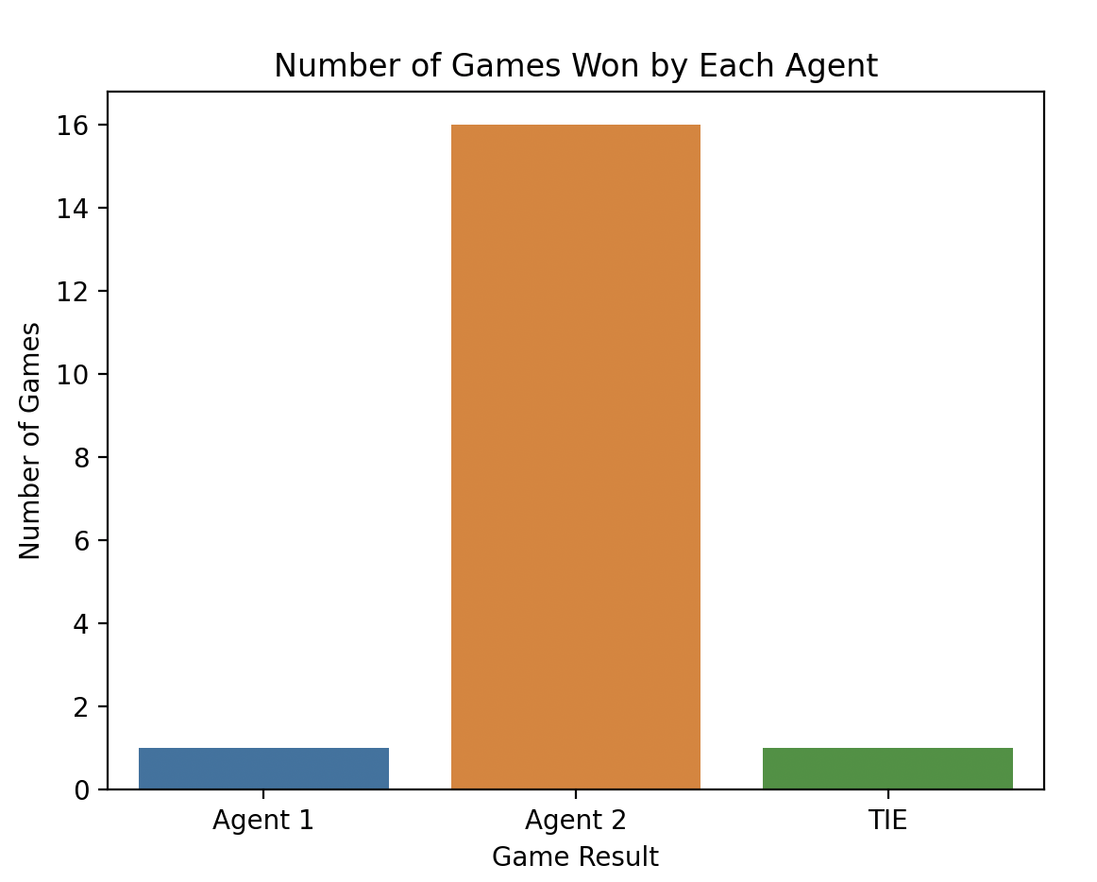
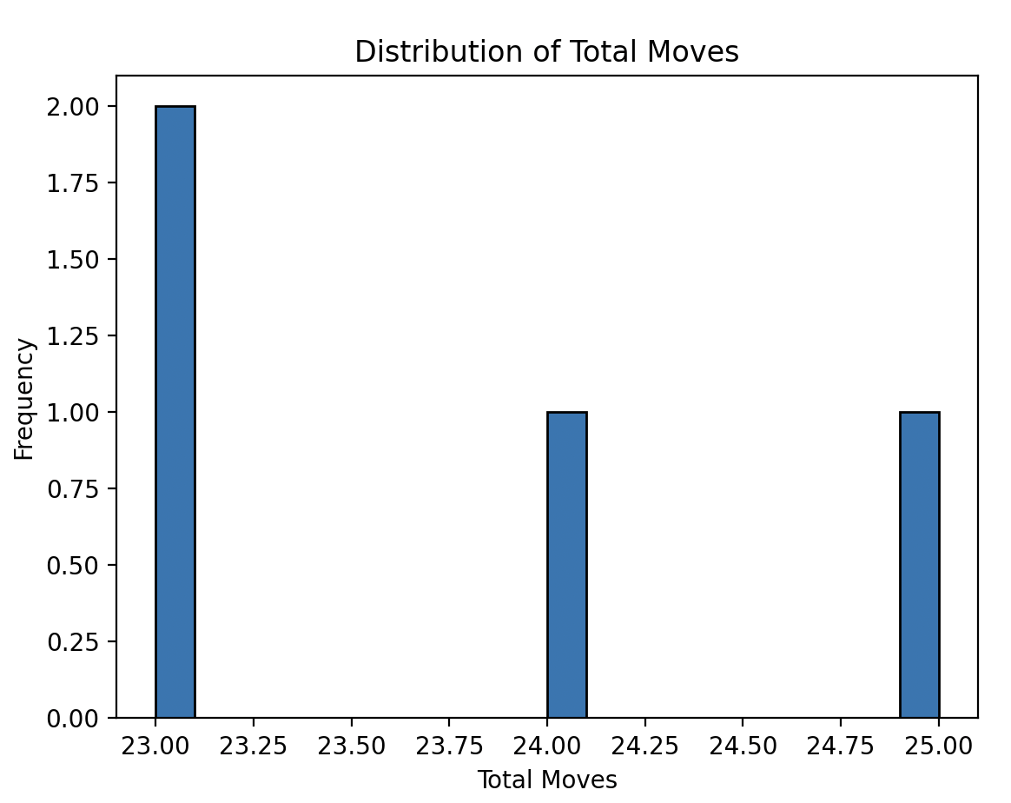
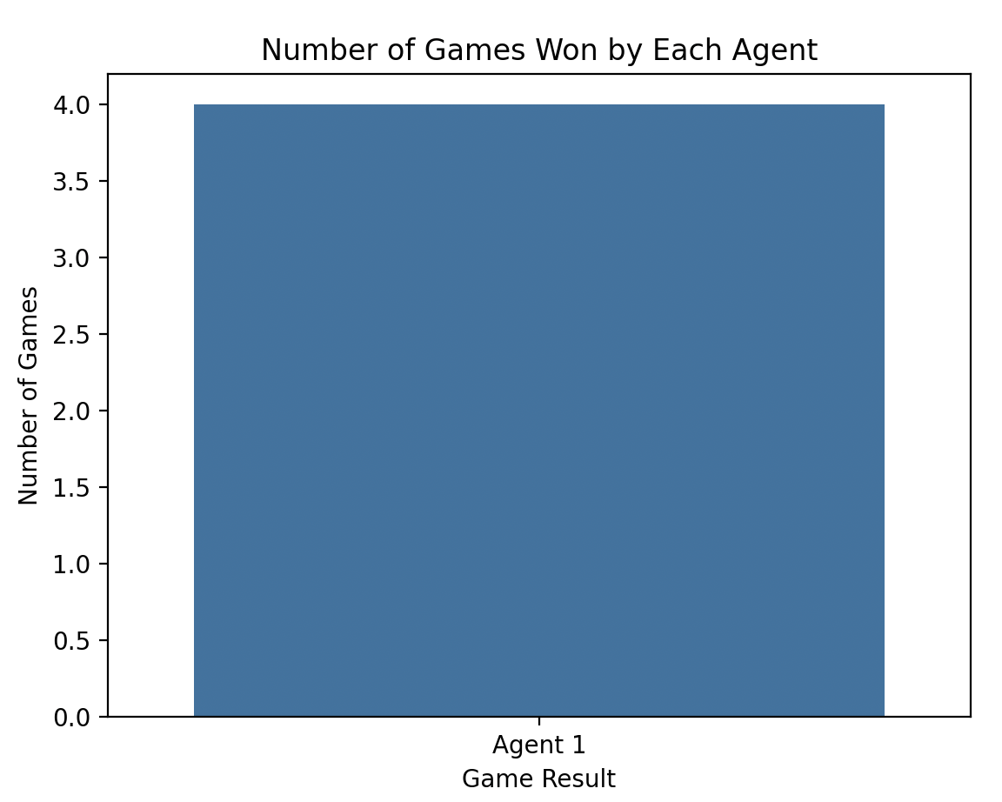
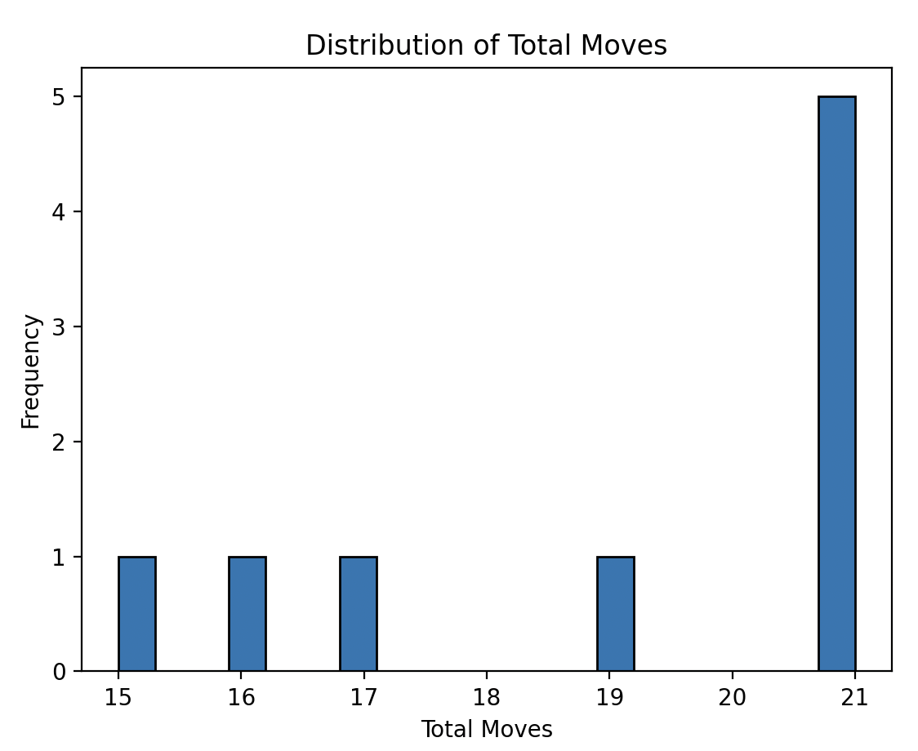
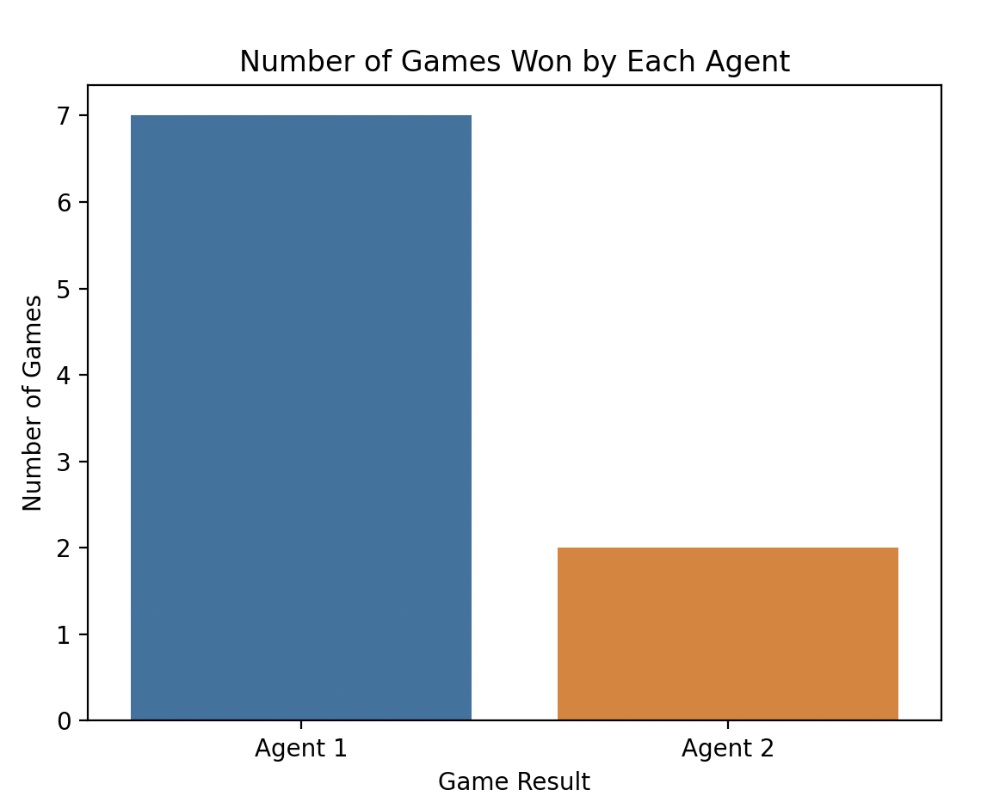
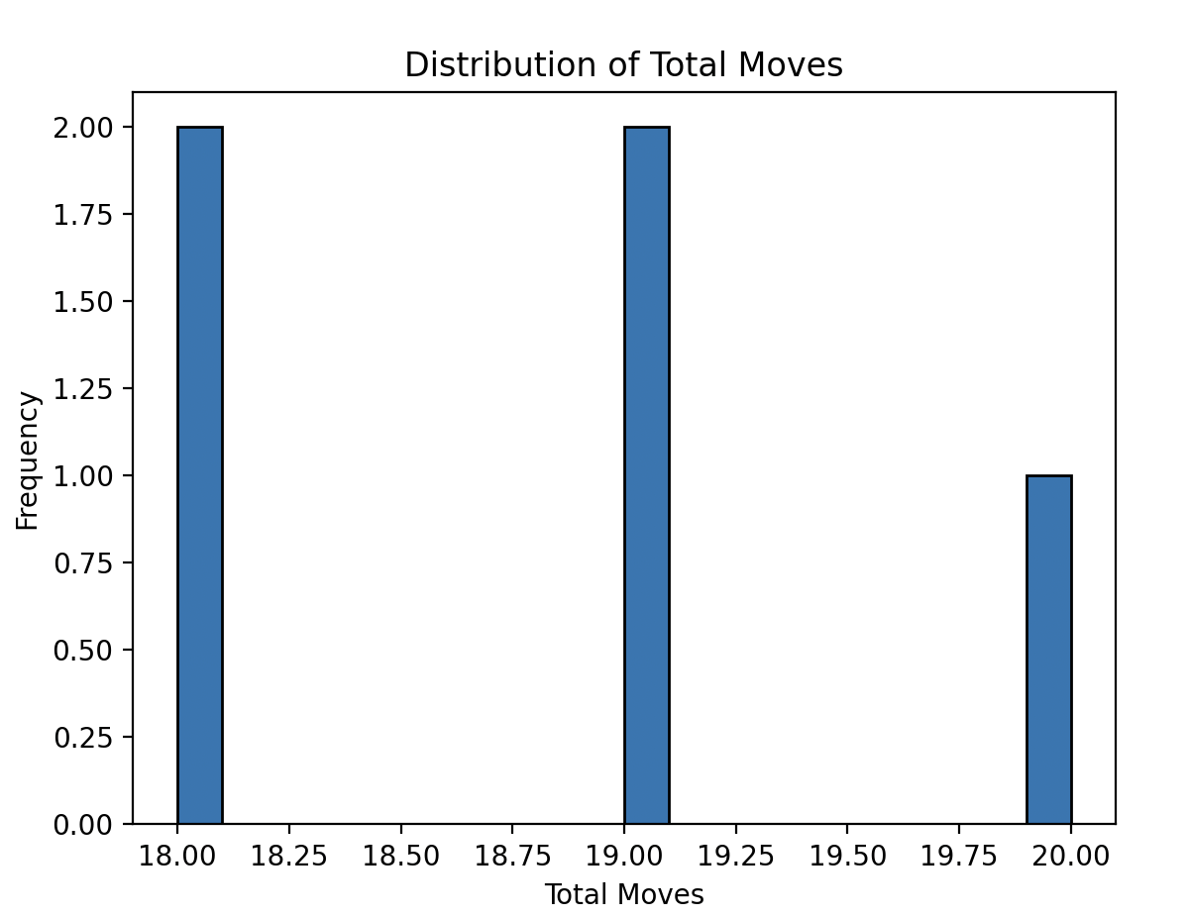
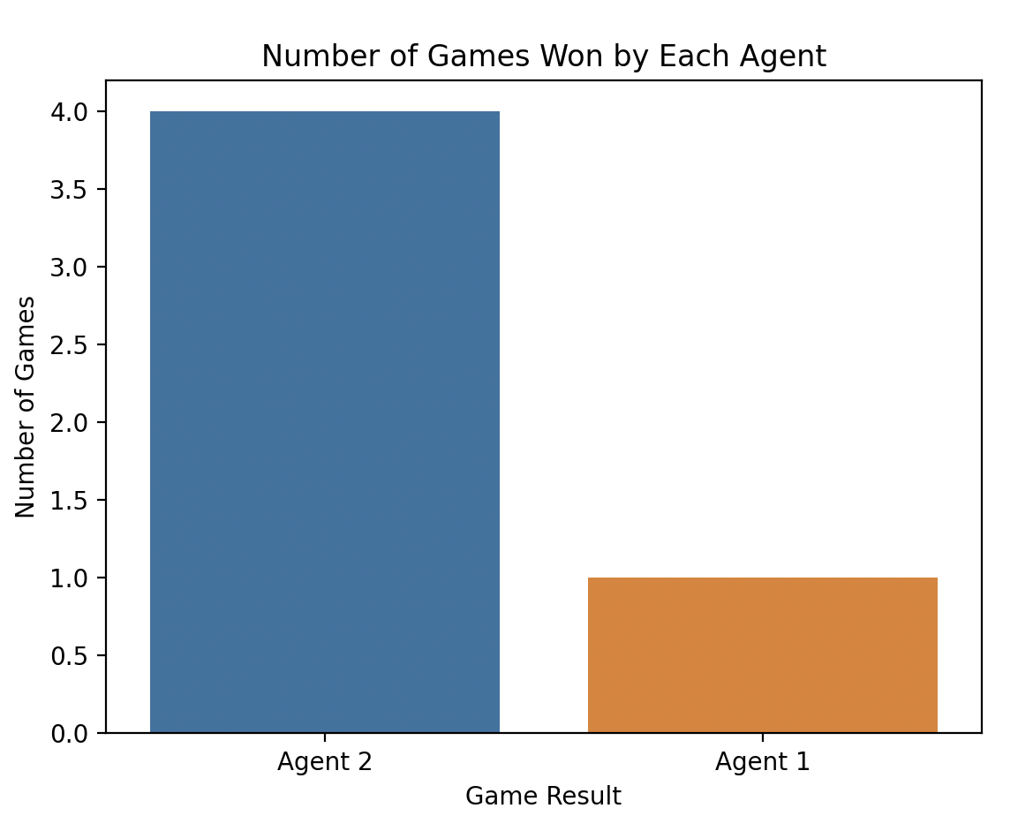
Results
Figure 1. Random_vs_AB
Figure 2. AB_vs_random
Figure 3. AB_vs_Part_geni
Figure 4. Part_geni_vs_AB
Notes:
Bowblis, J. R., Meng, H., & Hyer, K. (2013). The Urban-Rural Disparity in Nursing Home Quality Indicators: The Case of Facility-Acquired Contractures. Health Services Research, 48(1), 47-69. doi:10.1111/j.1475-6773.2012.01431.x

Slide 11
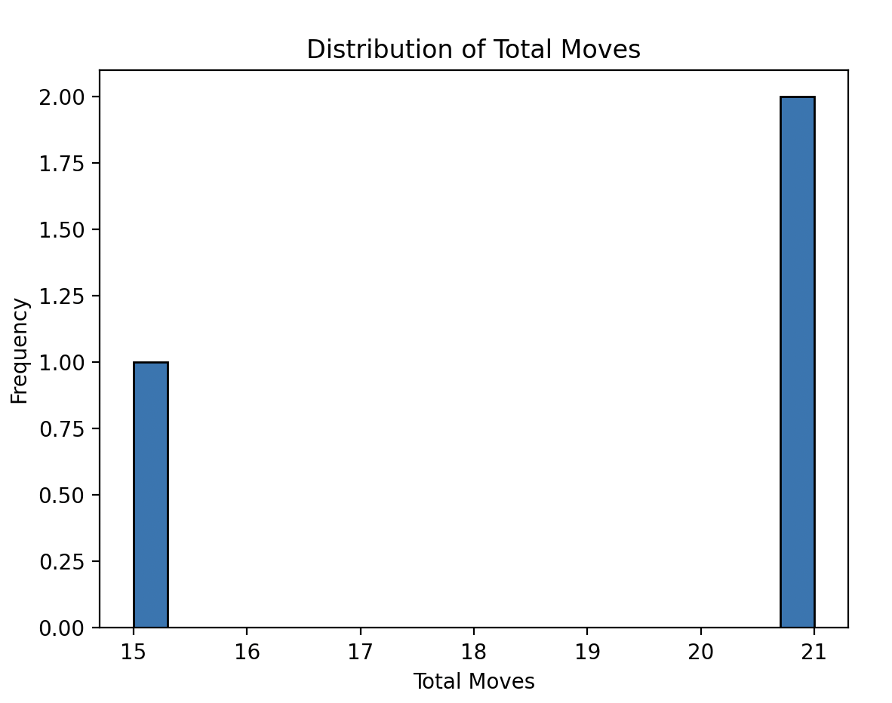
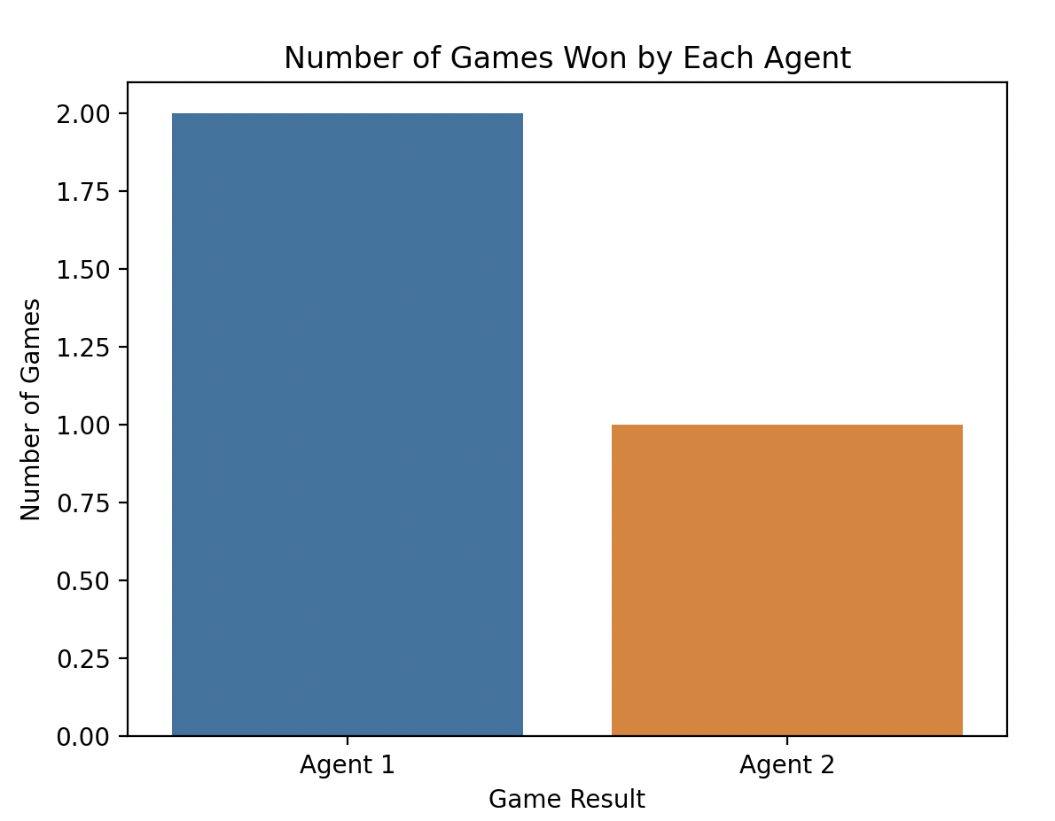
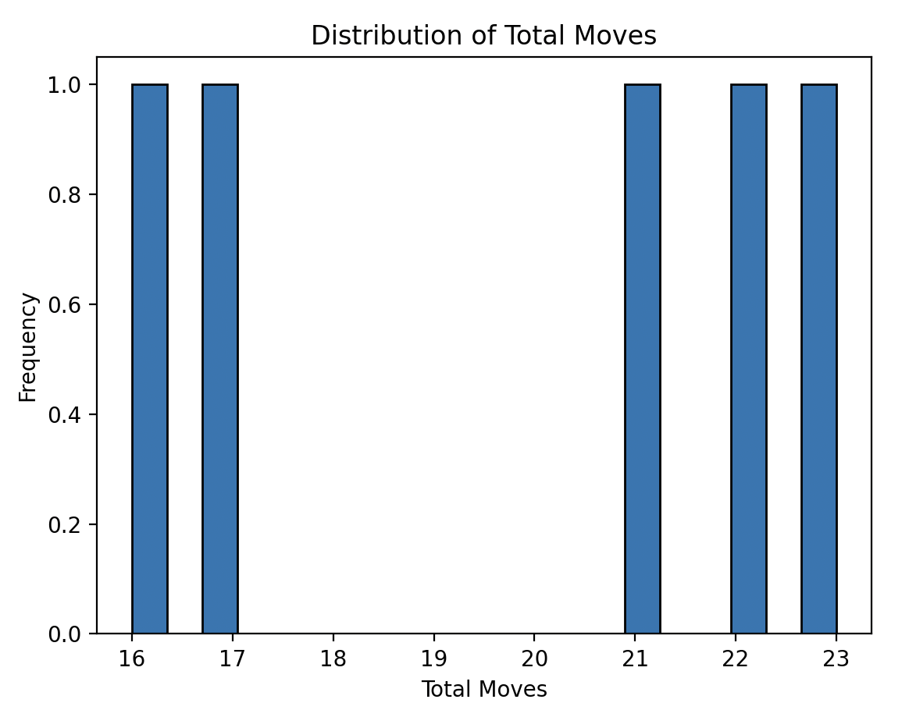
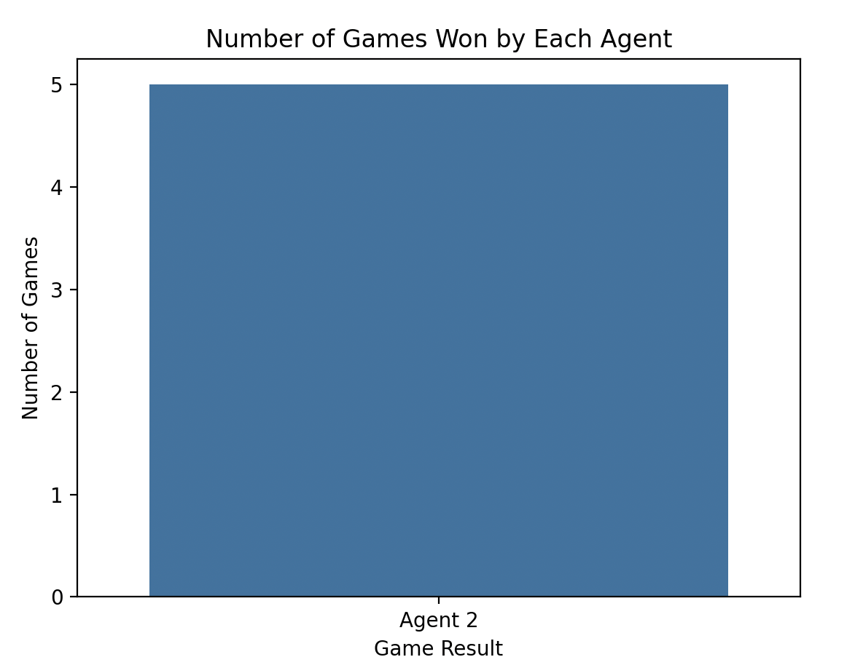
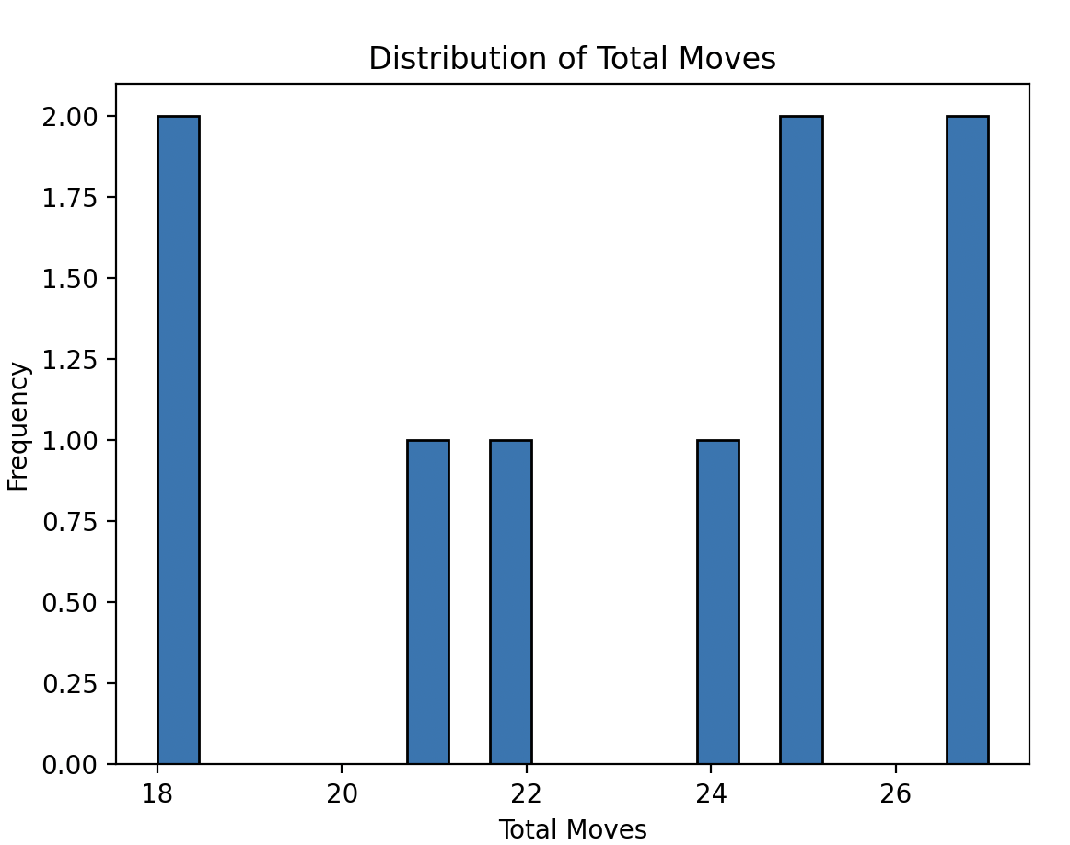
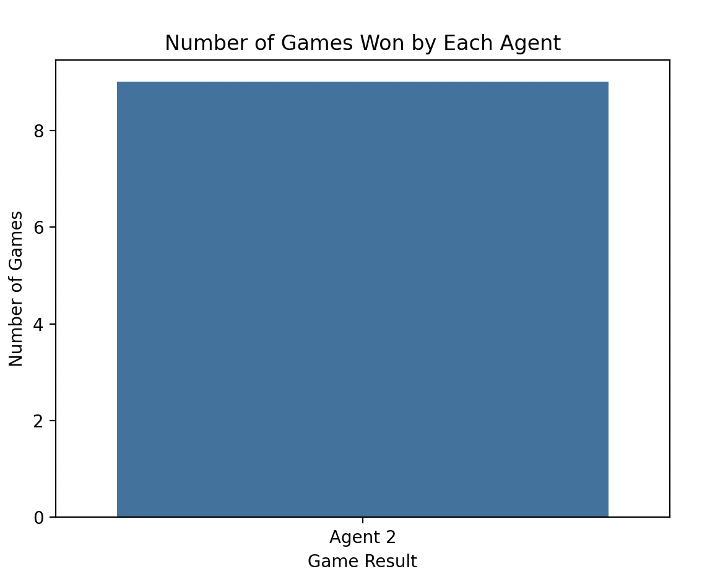
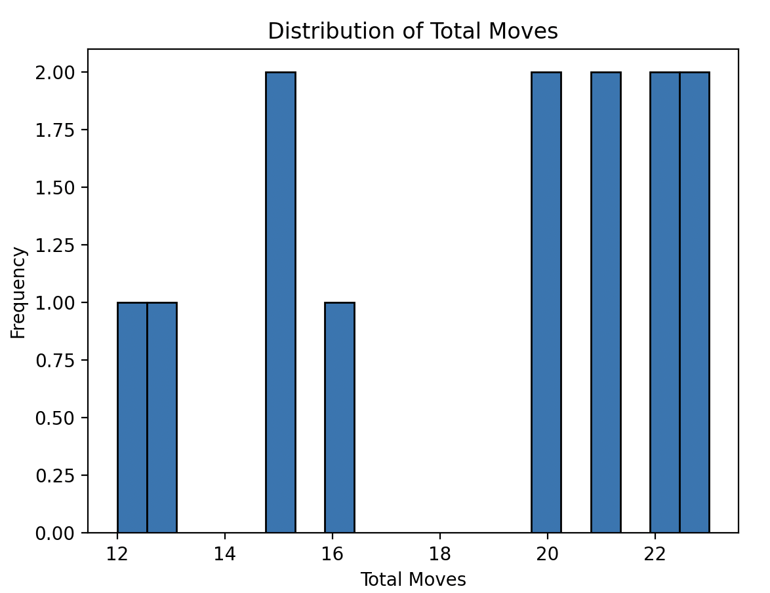
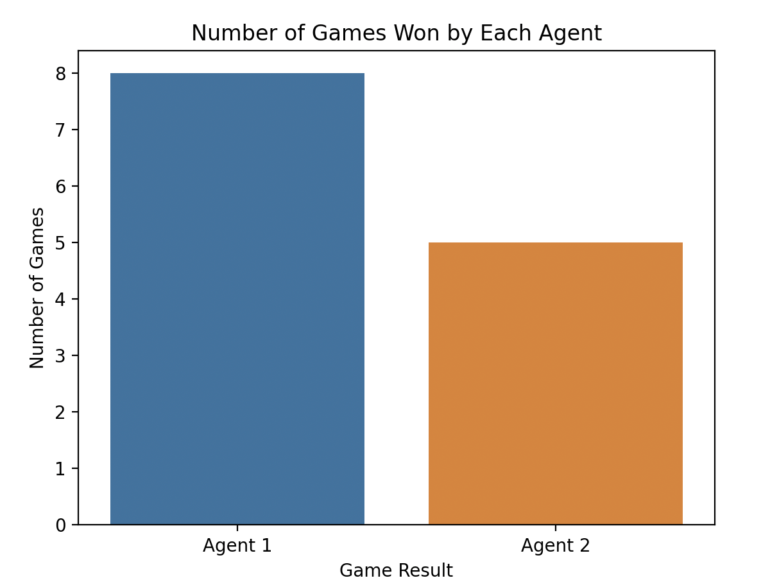
Figure 5. Part_geni_vs_minmax
Figure 6. Random_vs_Part_geni
Figure 7. Random_vs_minmax
Figure 8. Part_geni_vs_Random

Slide 12
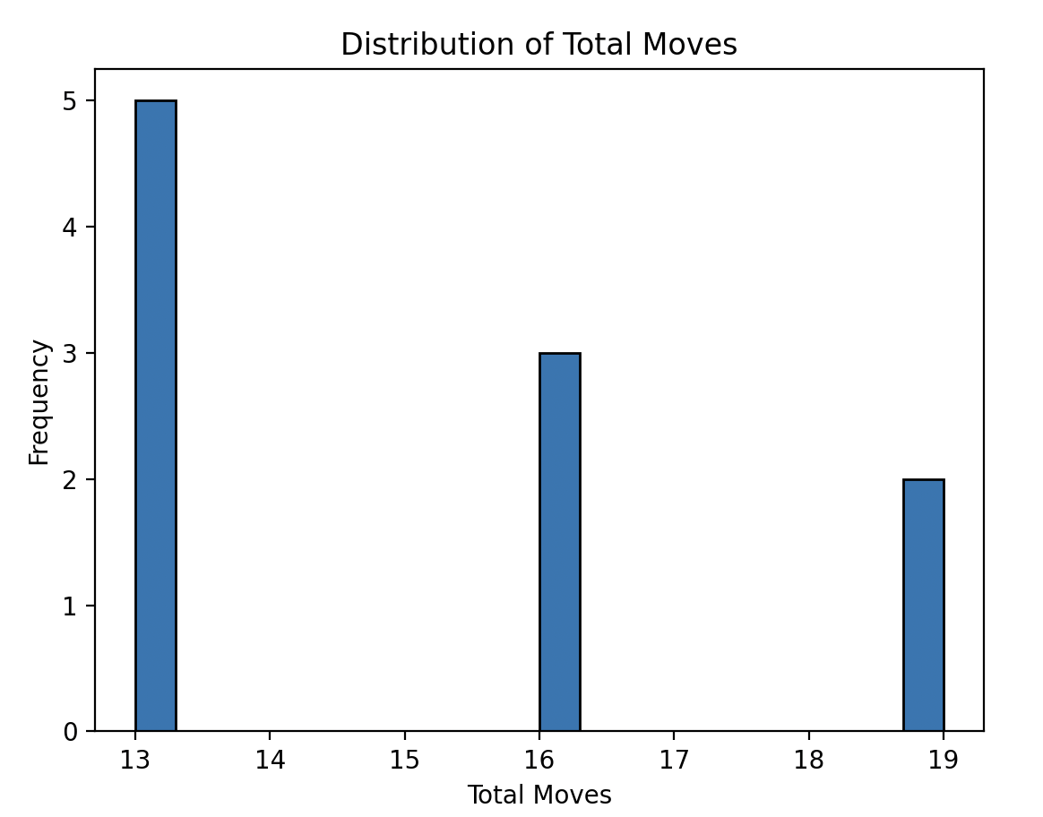
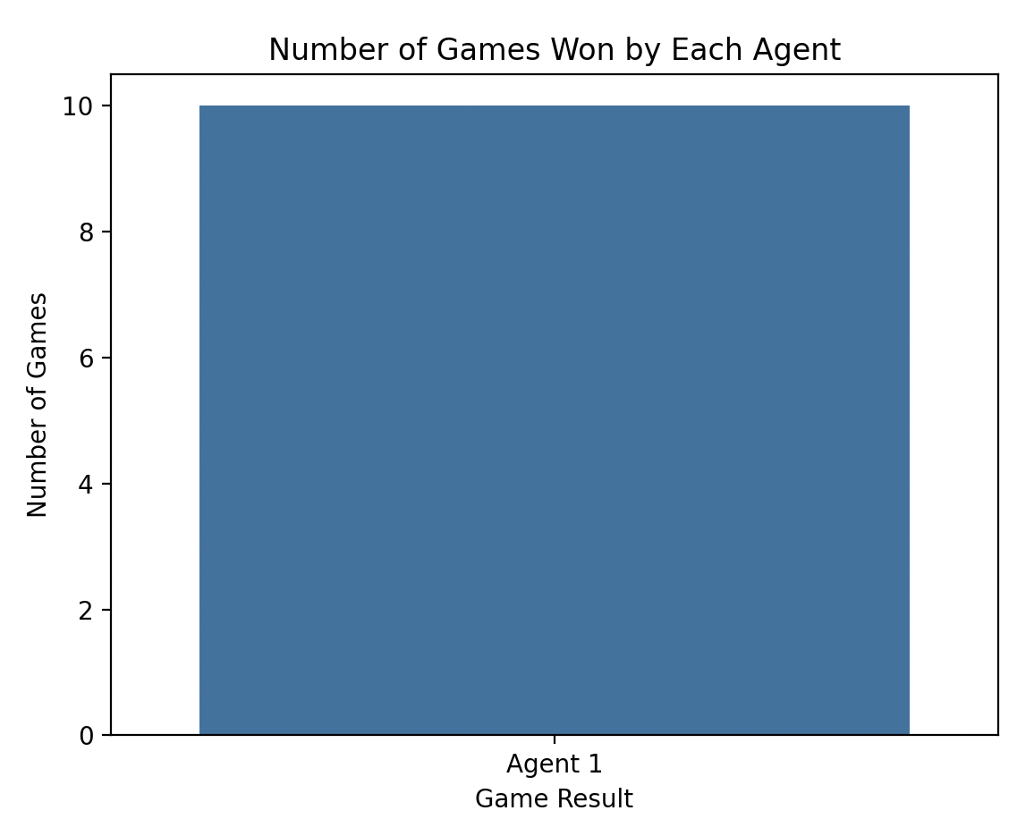
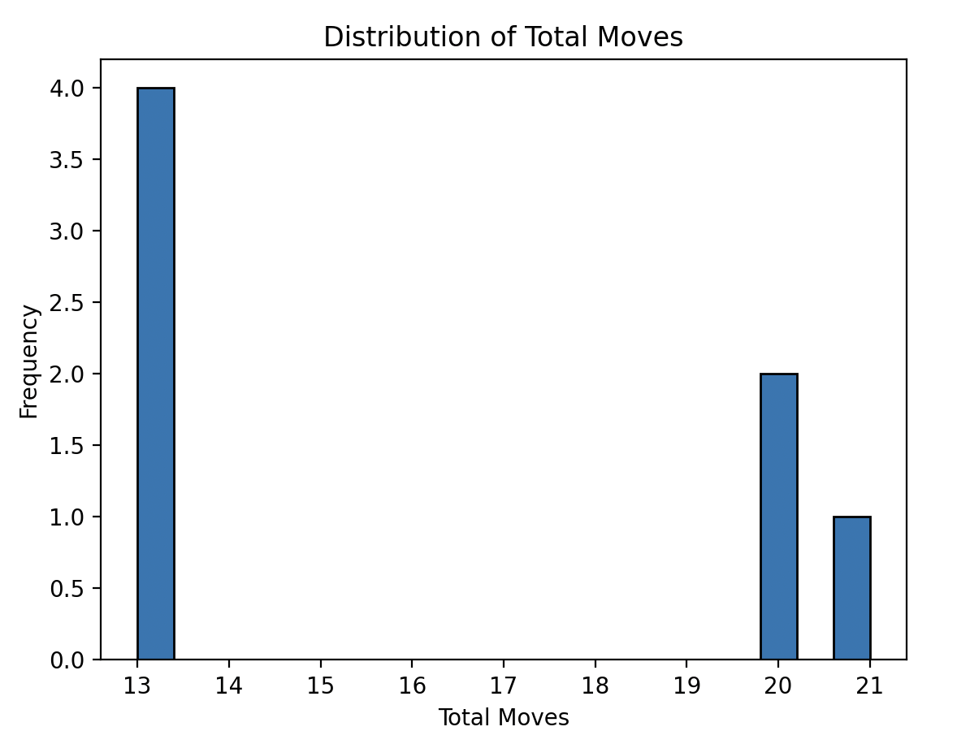
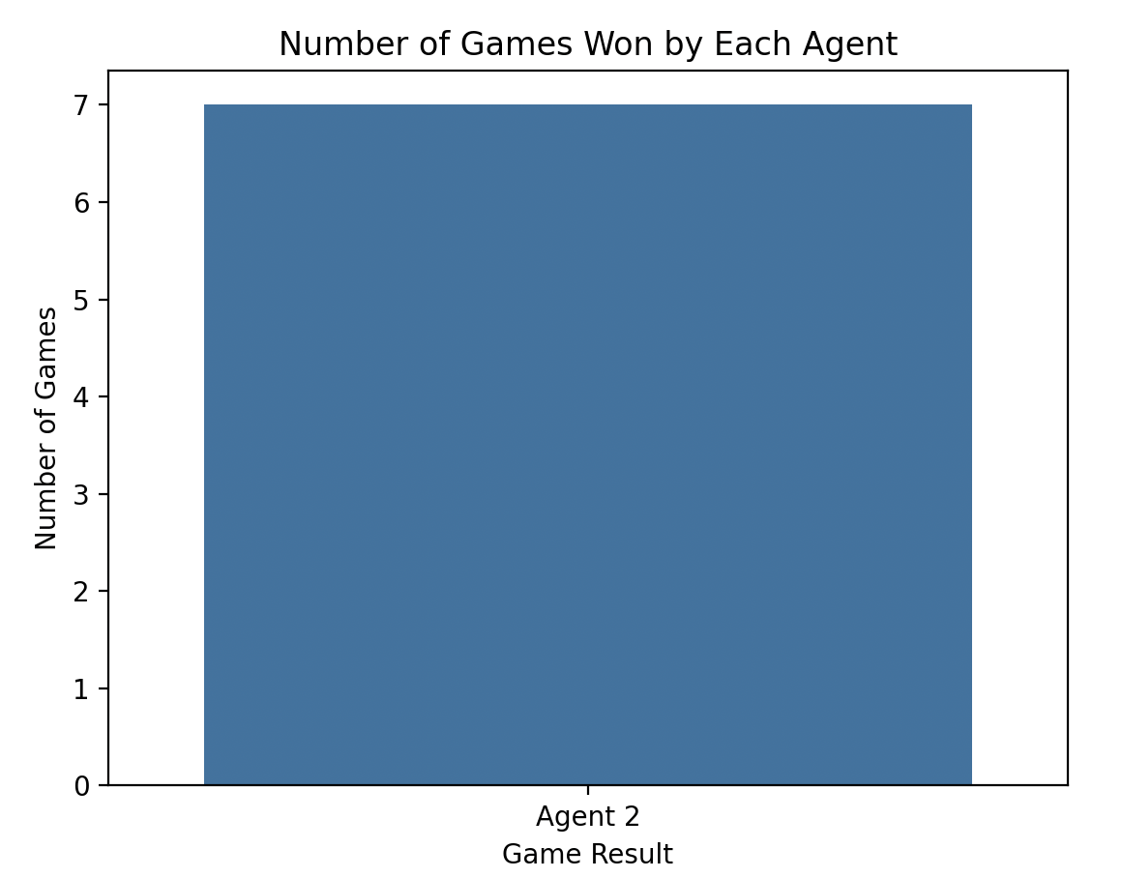
Figure 9. AB_vs_minmax
Figure 10. Minmax_vs_AB
Efficient Memorization: In some of the heuristic algorithms used, the project leverages memoization to store previously computed board evaluations. This approach speeds up subsequent evaluations, optimizing the game's performance during real-time gameplay.
The project evaluates various AI algorithms' performance and provides valuable insights into which AI strategies are most suitable for particular game scenarios, leading to informed decisions for future development and improvements.

Slide 13
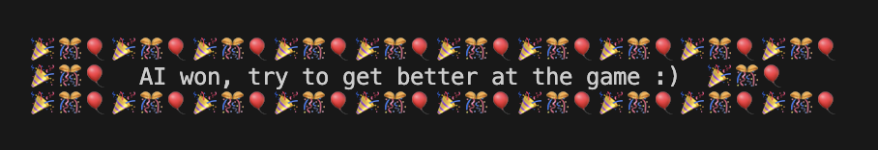
Conclusion
In conclusion, project on the design and development of a board game incorporating tactical decision-making and strategic planning has been a success. Comprehensive exploration of various AI approaches, game mechanics, and data-driven analysis were embarked. Key findings from the research include the implementation of diverse AI algorithms, such as heuristics, minimax, alpha-beta pruning, and adversarial search. These strategies have transformed the game into an engaging and challenging experience, prompting players to think critically and plan strategically. The introduction of the innovative "Strategic Tic-Tac-Toe" board added complexity and excitement, elevating the gameplay to new heights. Preliminary play-testing confirmed the effectiveness of the approach, motivating to further refine and expand the game.
Notes:
Bowblis, J. R., Meng, H., & Hyer, K. (2013). The Urban-Rural Disparity in Nursing Home Quality Indicators: The Case of Facility-Acquired Contractures. Health Services Research, 48(1), 47-69. doi:10.1111/j.1475-6773.2012.01431.x

Slide 14

Future Work
The project identifies areas for future research, including investigating adversarial search algorithms( finding better and more detailed heuristics) and memory-based techniques. It's possible to remember the whole history of a game and use it during the play. This not only expands the research horizons but also indicates a willingness to continuously improve the game and its AI components.
Additionally, researching deep into
various techniques used behind
the AlphaZero, Stockfish,
Deep Blue(IBM100).
Implementation of AI agent into
playable multi platform apps.
Notes:
Bowblis, J. R., Meng, H., & Hyer, K. (2013). The Urban-Rural Disparity in Nursing Home Quality Indicators: The Case of Facility-Acquired Contractures. Health Services Research, 48(1), 47-69. doi:10.1111/j.1475-6773.2012.01431.x

Slide 15
Questions?

